Slide 1

Explainable AI‑ Based Crop & Organic Pest Recommendation System
Using Soil and Dynamic Weather Data
TEAM MEMBERS:
P. Neha 2203A52168 K. Nikhitha 2203A52232 V. Vishishta 2203A52186 V. Janani 2203A52185 M. Avinash 2203A52227 M. Swetha 2203A52102
Guide: DR.ANURODH KUMAR Institution: SR University, Warangal

Slide 2
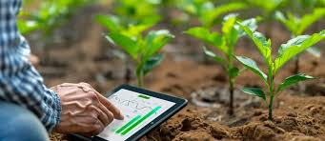
Slide Title
ABSTRACT
Develops an Explainable AI-based Crop & Organic Pest Recommendation System
Suggests suitable crops using soil nutrients (N, P, K), pH, and location data
Integrates real-time weather data for better prediction accuracy
Uses multiple ML models: Random Forest, Decision Tree, Logistic Regression, KNN, SVM
Random Forest gives highest accuracy in crop prediction
Built using Python and Flask with a user-friendly web interface
Includes Explainable AI (XAI) to show how predictions are made
Recommends organic pest control methods
Promotes sustainable and eco-friendly farming
Helps increase crop yield and reduce farming risks

Slide 3
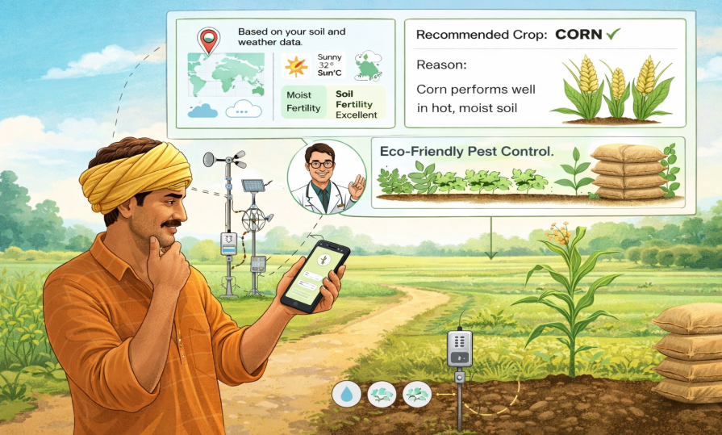
Slide Title
Problem statement
Lack of access to expert agricultural guidance leads to poor decision-making
Crop selection based on guesswork and experience reduces yield quality
Soil fertility and weather conditions vary, affecting crop suitability
Traditional methods do not use real-time weather data
Limited awareness of data-driven and scientific farming techniques
Dependence on chemical pest control and lack of eco-friendly solutions
Improper crop selection can result in financial losses for farmers
Limited access to modern tools and technologies in rural areas

Slide 4
Table
S.No | Year | Title | Abstract | Implementation
1 | 2023 | Machine Learning-Based Optimal Crop Selection System in Smart Agriculture | ML system using weather and soil data. Uses LSTM for weather prediction and Random Forest for crop selection with ~97% accuracy. | LSTM predicts weather (temperature, rainfall). Random Forest uses soil + predicted weather for crop and sowing time recommendation.
2 | 2023 | Streamlit Application for Advanced Ensemble Systems | Ensemble ML models are combined and deployed using Streamlit to improve accuracy and provide interactive user experience. | Uses voting/bagging ensemble techniques. Streamlit provides real-time UI and prediction interface.
3 | 2023 | Data-Driven Crop and Fertilizer Recommendation System | Neural Network and rule-based system integrated with IoT data for crop and fertilizer recommendation with ~97% accuracy. | Neural Network predicts crops using NPK and pH values. Rule-based logic suggests fertilizers based on soil conditions.
4 | 2025 | AI for Sustainable Agriculture: A Comprehensive Review | Reviews ML, DL, and time-series models (SVM, CNN, RNN) for crop prediction, yield estimation, and resource management. | Pipeline: data collection → preprocessing → ML/DL models. Used for prediction, classification, and agricultural decision-making.
5 | 2025 | ML-Based Frameworks for Reliable and Sustainable Crop Forecasting | Reviews ML/DL frameworks using satellite, weather, and soil data for crop yield prediction and health monitoring. | Feature extraction (e.g., NDVI) from remote sensing data. ML/DL models predict crop yield and monitor crop health.
6 | 2024 | Revolutionizing Crop Disease Detection with Computational Deep Learning | Reviews ML and DL techniques like CNN and SVM for crop disease detection. Discusses datasets, methods, and research gaps. | Collects plant leaf images and preprocesses them. Extracts features and trains CNN/SVM models for disease classification. Evaluates accuracy of different algorithms.

Slide 5
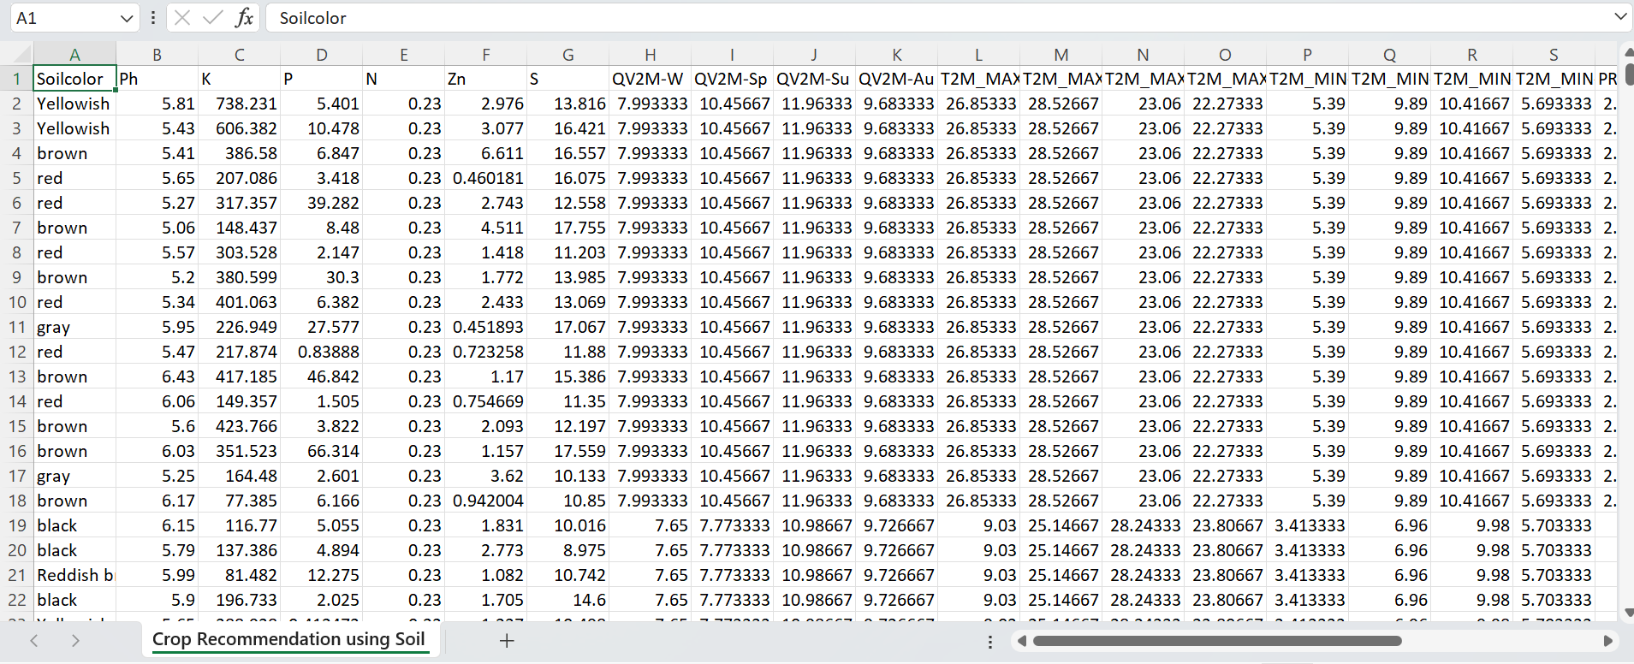
Slide Title
Proposed Solution
Our dataset contains 57,000 rows and 8 columns representing soil and environmental features
used for training and testing machine learning models.
The dataset is used for predicting suitable crops
based on soil and climatic conditions.
The dataset link:Crop Recommendation Dataset
https://share.google/tdNrFIGv45URg7WLK
Input: N, P, K, pH, temperature, humidity, rainfall,
and label – crop type.
Output : Crop Name (Target Variable)
These features help the model understand soil fertility
and environmental conditions.

Slide 6
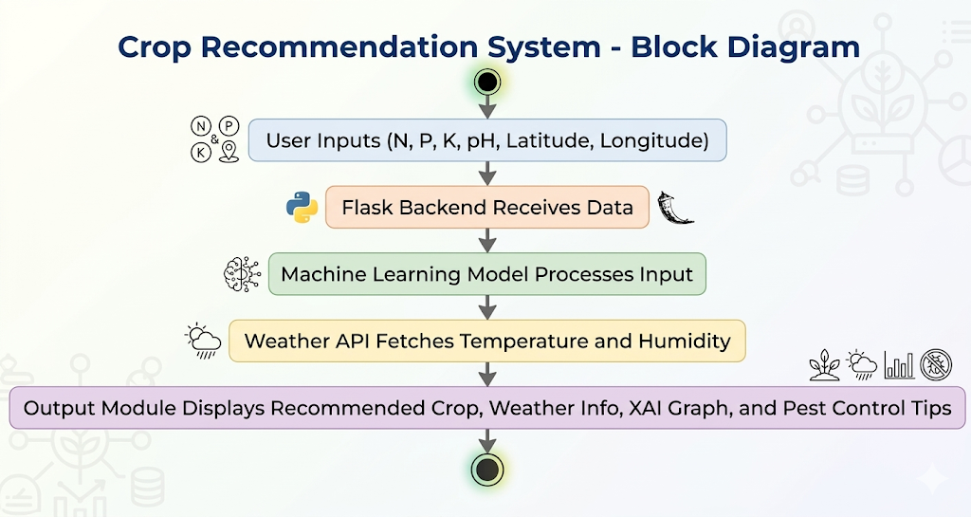
Slide Title
System Architecture

Slide 7
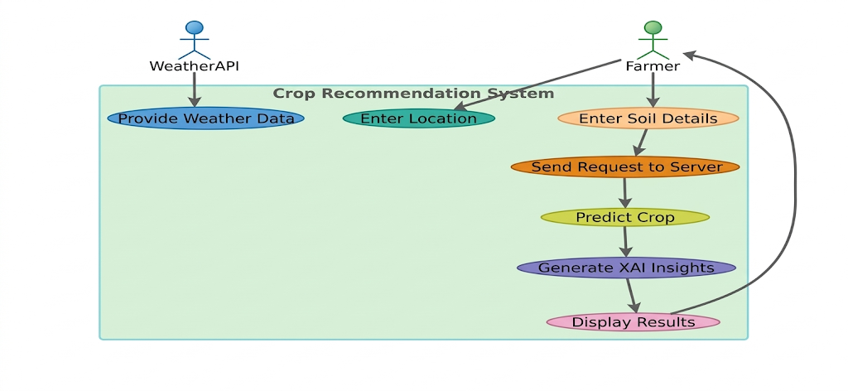
Slide Title
Work Flow
Weather API provides weather data such as temperature, humidity, and rainfall.
Farmer enters location and soil details (N, P, K, pH).
The system sends the data to the server for processing.
A machine learning model predicts the most suitable crop.
XAI (Explainable AI) generates insights explaining the recommendation.
The final crop recommendation and explanation are displayed to the farmer.

Slide 8
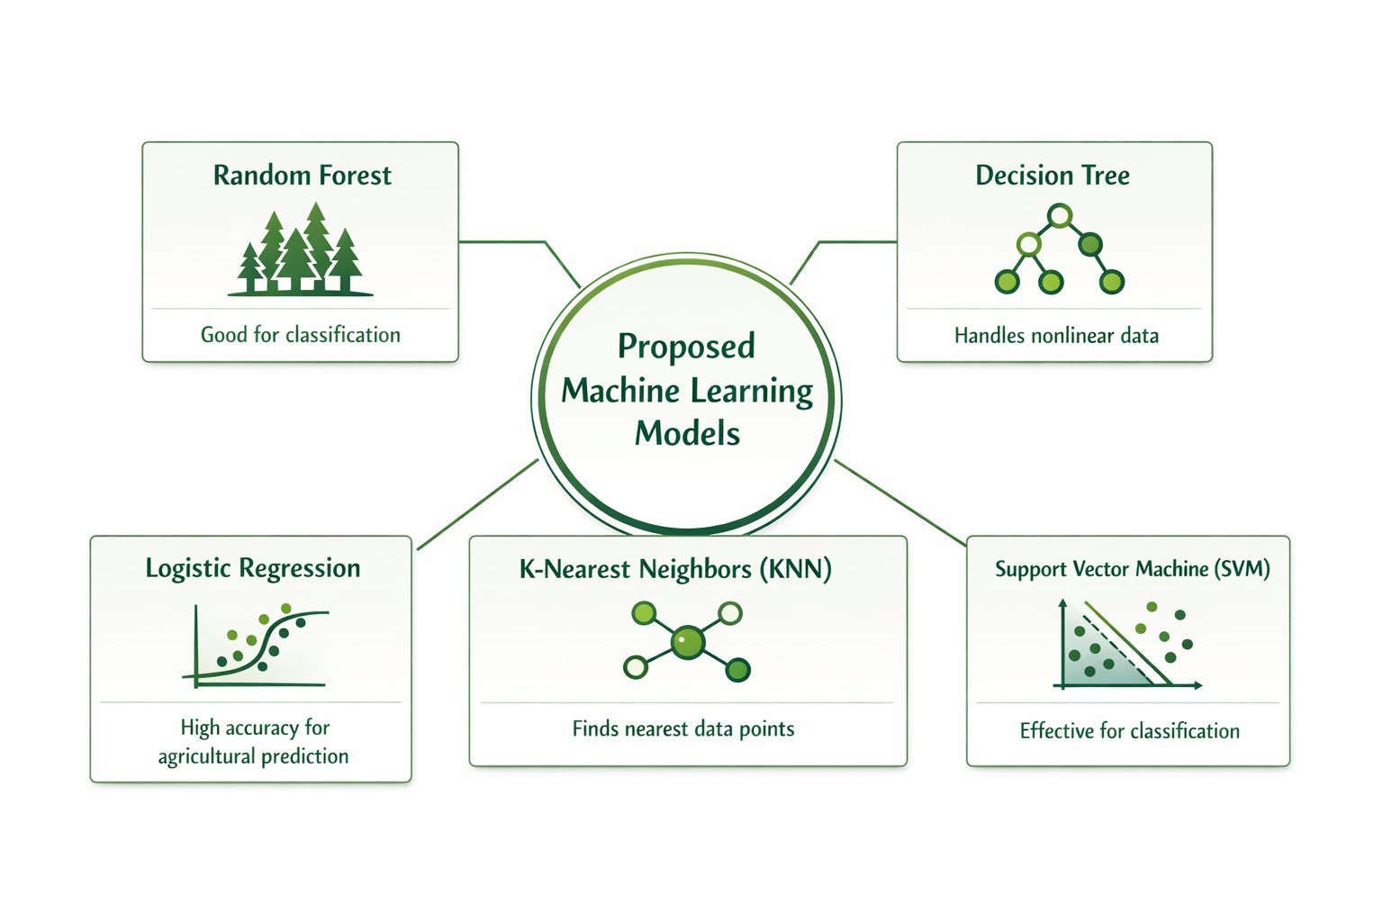
Slide Title
Technology
The following machine learning models are proposed:
Random Forest Classifier
Decision Tree Classifier
Logistic Regression
K-Nearest Neighbors (KNN)
Support Vector Machine (SVM)
These models are chosen because:
They perform well on classification tasks.
They handle nonlinear data effectively.
They provide good accuracy for agricultural prediction systems.

Slide 9
Slide Title
Results & Performance
.
Model | Accuracy | Precision | Recall | F1 Score | Loss %
Random Forest | 91.92 | 92.30 | 91.92 | 91.81 | 8.08
Decision Tree | 88.75 | 88.71 | 88.75 | 88.73 | 11.25
Logistic Regression | 81.17 | 80.73 | 81.17 | 80.54 | 18.83
KNN | 88.12 | 88.38 | 88.12 | 88.11 | 11.88
SVM | 87.33 | 88.84 | 87.33 | 86.82 | 12.67

Slide 10
Slide Title
Results & Performance
Why Random Forest is Best:
Highest Accuracy (91%) – It correctly predicts more samples compared to other models.
Balanced Precision and Recall – It maintains strong performance across all classes.
Higher F1-Score – Shows good balance between precision and recall.
Reduces Overfitting – Unlike Decision Tree, it uses multiple trees and averages results.
Handles Complex Data Well – Works better with nonlinear relationships and large feature sets.
More Stable – Less sensitive to noise compared to single models like Logistic Regression or Naive Bayes.
Conclusion:
Random Forest performs best because it combines multiple decision trees, reduces variance, improves generalization, and provides the most consistent performance among all models.

Slide 11
Slide Title
Experimental Setup & Results
Accuracy: Existing models achieve 85–90%, while proposed system reaches ~91%
Models: Papers use SVM, CNN, RNN, LSTM, basic ML models; proposed uses multiple models with optimized Random Forest
Data Usage: Existing works use limited data (soil OR weather); proposed uses soil (NPK, pH) + location + real-time weather
Weather Integration: Many use static/predicted data; proposed uses dynamic real-time weather data
Approach: Existing systems are single/basic models; proposed uses multi-model comparison + Explainable AI (XAI)
Explainability: Limited in papers; proposed system provides clear prediction explanations
Deployment: Mostly theoretical/offline; proposed is a Flask-based web application
Additional Feature: Existing focus on crop prediction; proposed also gives organic pest control suggestions
Conclusion: Proposed system is more accurate (~91%), practical, transparent, and user-friendly compared to existing research.

Slide 12

Slide Title
Overview of Output
Fig 1.1

Slide 13
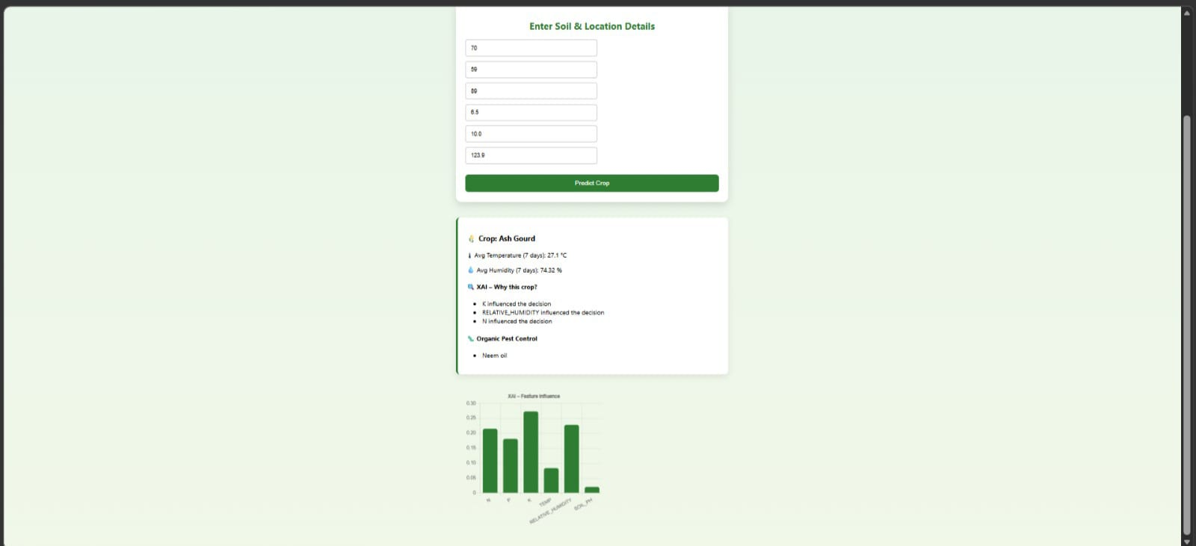
Fig 1.2

Slide 14

Fig 1.3

Slide 15

Fig 1.4

Slide 16
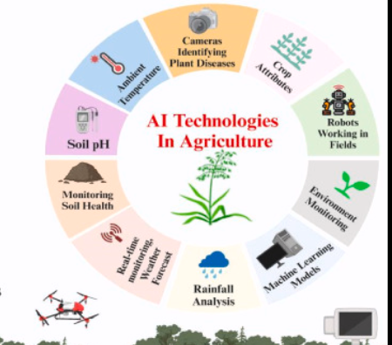
Slide Title
Conclusion
Developed a Machine Learning–based Crop Recommendation System that suggests suitable crops using soil nutrients (N, P, K), pH, temperature, humidity, and rainfall data.
Implemented and compared multiple ML models such as Random Forest, Decision Tree, SVM, Logistic Regression, and KNN to evaluate performance.
Random Forest achieved the highest accuracy, making it the most effective model for crop prediction.
Integrated real‑time weather data using OpenWeather API, improving the accuracy and practicality of recommendations.
Added Explainable AI (LIME) to show the important factors influencing predictions, increasing transparency and trust.
Built a Flask‑based web interface, making the system easy for farmers to use and helping them make data‑driven agricultural decisions.

Slide 17
References
Ngugi, H.N., Ezugwu, A.E., Akinyelu, A.A. et al. Revolutionizing crop disease detection with computational deep learning: a comprehensive review. Environ Monit Assess 196, 302 (2024). https://doi.org/10.1007/s10661-024-12454-z
Musanase, C.; Vodacek, A.; Hanyurwimfura, D.; Uwitonze, A.; Kabandana, I. Data-Driven Analysis and Machine Learning-Based Crop and Fertilizer Recommendation System for Revolutionizing Farming Practices. Agriculture 2023, 13, 2141. https://doi.org/10.3390/ agriculture13112141
Citation: Ali, Z.; Muhammad, A.; Lee, N.; Waqar, M.; Lee, S.W. Artificial Intelligence for Sustainable Agriculture: AComprehensive Review of AI-Driven Technologies in Crop Production. Sustainability 2025, 17, 2281. https://doi.org/10.3390/ su17052281 Citation: Singh,K.; Yadav,M.;Barak, D.; Bansal, S.; Moreira, F. Machine-Learning-Based Frameworks for Reliable and Sustainable Crop Forecasting. Sustainability 2025, 17, 4711. https://doi.org/10.3390/ su17104711 Rani, S., Mishra, A.K., Kataria, A. et al. Machine learning-based optimal crop selection system in smart agriculture. Sci Rep 13, 15997 (2023). https://doi.org/10.1038/s41598-023-42356-y Shams, M.Y., Gamel, S.A. & Talaat, F.M. Enhancing crop recommendation systems with explainable artificial intelligence: a study on agricultural decision-making. Neural Comput & Applic 36, 5695–5714 (2024).
https://doi.org/10.1007/s00521-023-09391-2

Slide 18

THANK YOU….

